Slide 1
Sprint Process Presentation
Group B3
Team members:
Tan Pei Sheng
Giyeong Lee
Cherry Kosasih
Louis Juliano
Ngeoh Khai Vin
Zeenath Zaeema Nashath

Slide 2
Stories in Sprint 3
Full backlog on Trello

Slide 3
NFR
User stories on trello are tagged with NFR attribute tags

Slide 4
Product contains the functionality the client was expecting
Required functionalities :
Login/Sign-up system
Super user page with account details
Dashboard for covid related information and charts
All of the above requirements have been satisfied in the form of user stories and was shown in the product demo

Slide 5
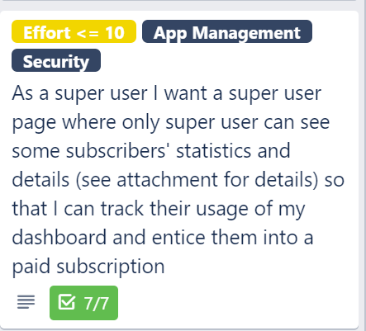
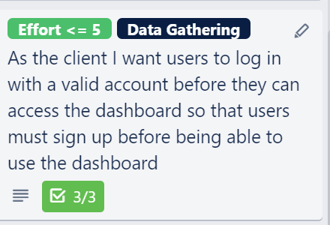
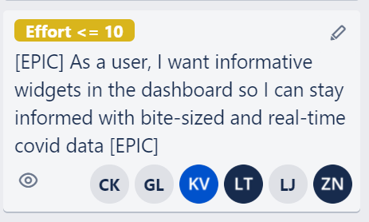
Valuable user stories

Slide 6
Product demo
Demo with streamlit

Slide 7
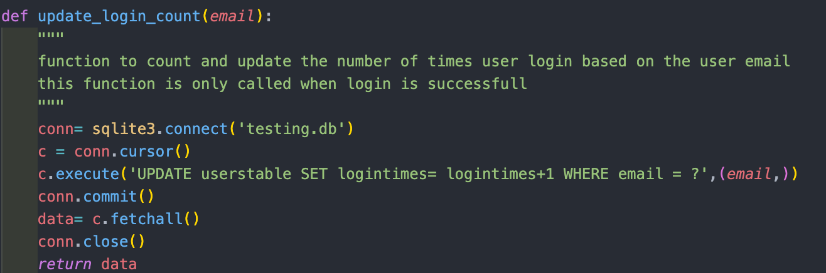
Definition of Done
Each feature syncs with user story
Code fully implements a feature requirement
Code is documented according to convention
Notes:
A user story is explanation of a feature from the perspective of client.The purpose of user story is to determine how we will deliver a value to client. Therefore, ofc feature must sync with user story so that we can deliver our work well to client.
Feature requirement from client is something developer should definitely fulfil
Code is documented to avoid confusion among developers because everyone collaborates

Slide 8
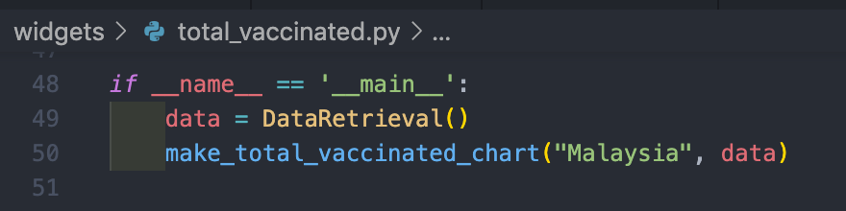
Definition of Done
4. Code has been reviewed
5. Code passes tests
Notes:
4. Code is reviewed by a QA person
5. Code must pass tests to ensure correctness

Slide 9
Maintenance
Our web app depends on
Our World In Data API (https://ourworldindata.org/)
Streamlit framework
Pandas library
Requires ongoing maintenance
Our App will throw errors if it meets failure

Slide 10
Limitations
Limited by API uptime
The News Widget only shows Malaysia news

Slide 11
API maintenance
Check whether API is still running
If deprecated use another API
Periodically check the API updates
The App is modulated, easy to add more widgets to upgrade
Cannot be automated
It is not possible to check if API is deprecated automatically

Slide 12
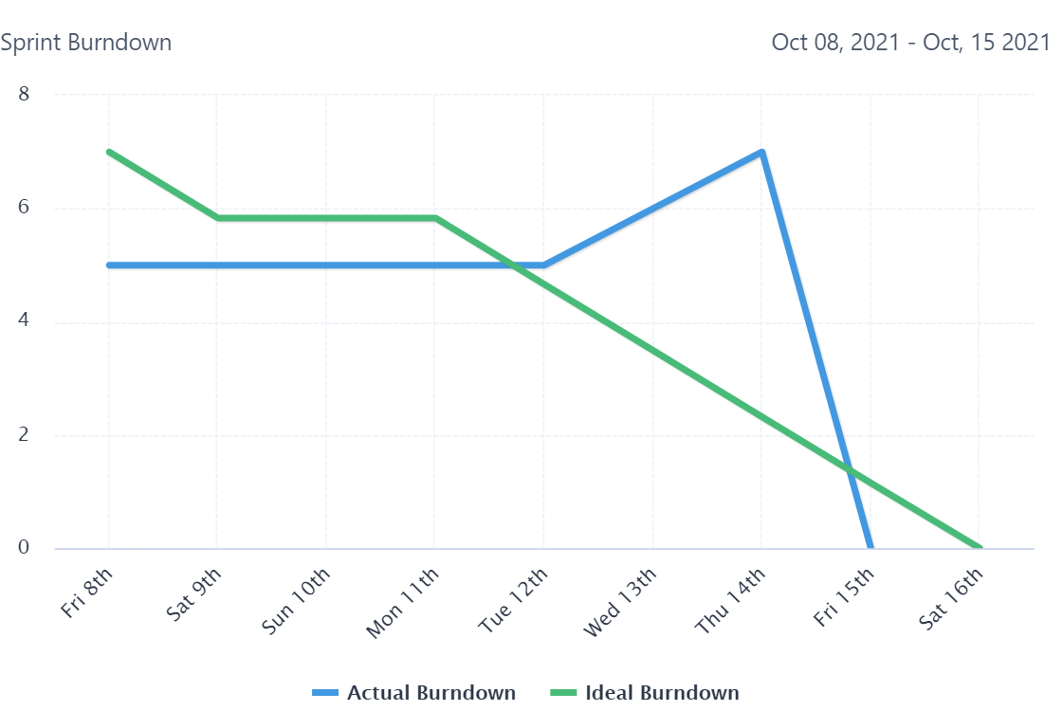
Time tracking
Unfortunately team did not
meet target velocity.
Managed to finish backlog
but need to work on
sustainable
Burndown rate.

Slide 13
Agile practices used
A product backlog and sprint backlog was used with both backlogs cleared by the end of Sprint 3
https://trello.com/b/jxoGeNJP/fit2101-group-b3-sprint-board
Scrum meetings were held every Monday at 2pm (over discord)
Meetings involved planning out sprints and retrospectives
A sprint goal was defined for each sprint
Planning poker was used by the team to make accurate user story estimates
A burndown chart was used to ensure a sustainable pace for each sprint

Slide 14
Member contribution and collaboration
Some user stories were completed together with two or more team members implementing separate tasks (see Trello)
The Product Owner (Pei Sheng) maintained the product backlog, took care of time tracking, defined the definition of done and briefed team on what to build for each iteration
Scrum Master (Zaeema Nashath) helped expedite decision making during meetings, helped with understanding Scrum practices and resolved disagreements within the team
The QA manager (Louis Juliano) tested all functionality and ensured the Definition of Done had been fulfilled before stories/ tasks could be confirmed as done
All members are part of the development team and were involved in the coding and completion of tasks and user stories

Slide 15
Risks occurred
Poor time management (External assignments from other classes clashing with sprint schedule)
Did not meet target velocity
Implement a set of tasks during sprint planning
Estimate how long a task will be taken to complete
Communicate with the development team through the daily scrum

Slide 16
Git usage
Mainly utilize the branches in git
Never push to master, push to your own branch
Then merge if no conflicts occured
Conflicts might mean that task are not allocated properly
To avoid conflicts, the order of pushing should be: Pull -> Commit -> Push
Commit messages are expected to be meaningful

Slide 17
Q & A

